Slide 1
bioSite: Ideas, Sketches and Inspiration
DeJanae Faison

Slide 2
Front-end Style Guide
TEXT
TEXT
Header 1
Header 2
Header 3
Fig Captions and Quotes
TEXT
Card
Button 1
Button 2
Button 3
Pressed 1
Pressed 2
Pressed 3
*Rounded edges
*Smooth transitions
*Sans Serif fonts

Slide 3
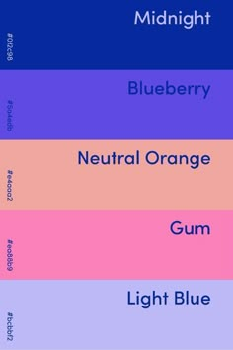
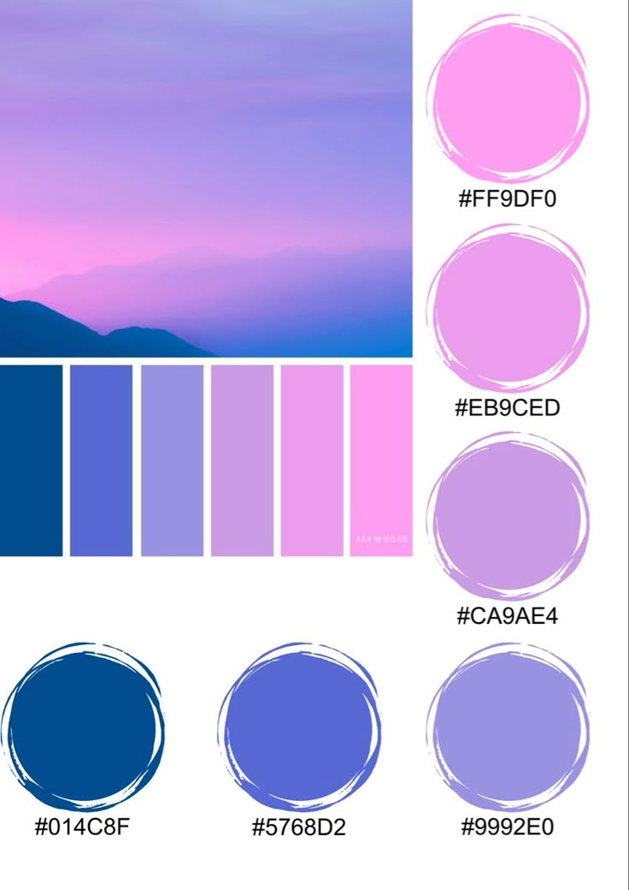
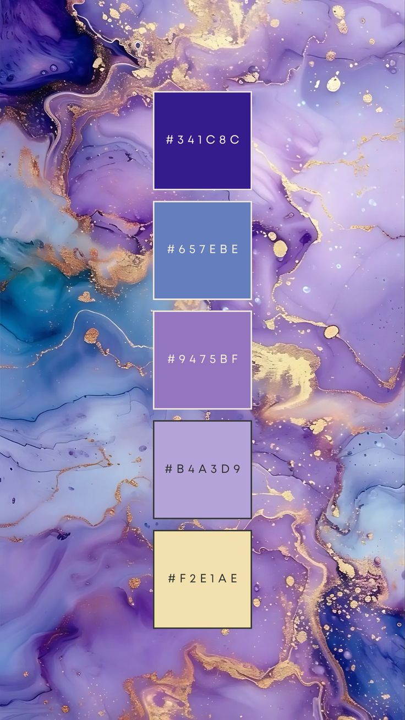
Front-end Style Guide: Color Palette Choices

Slide 4
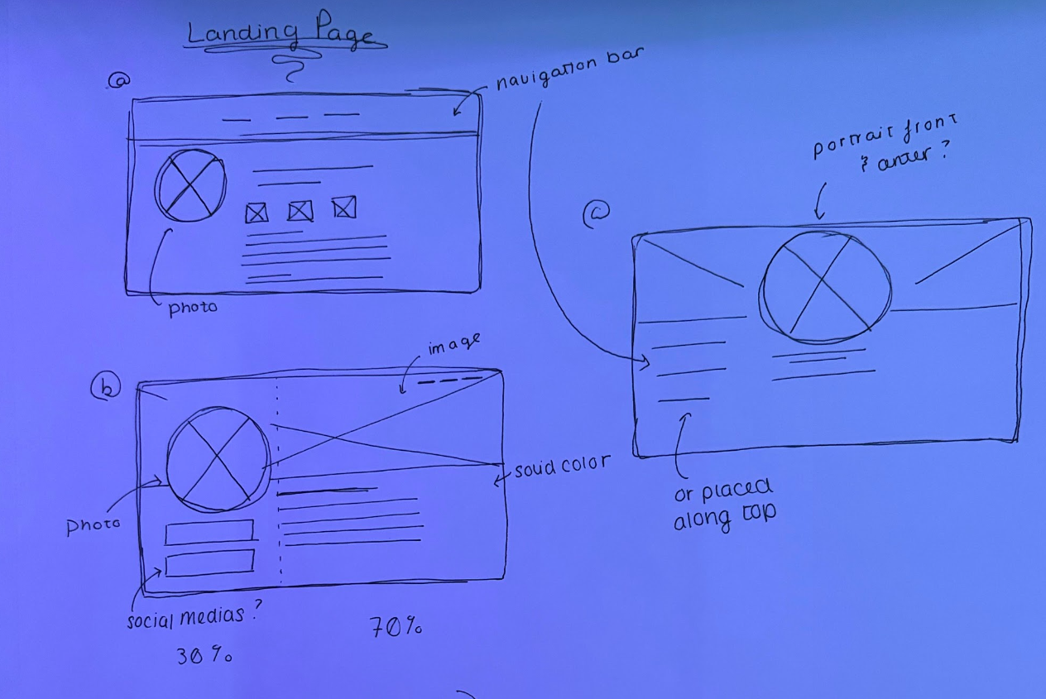
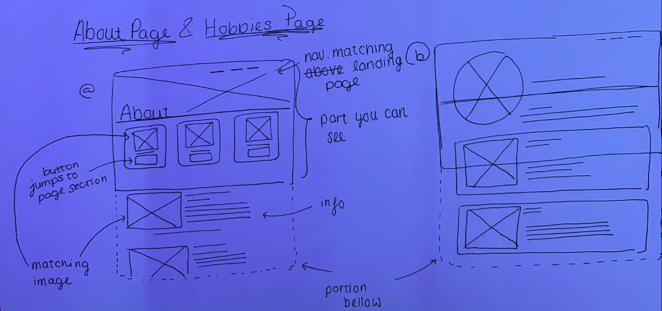
Wireframes and Sketches

Slide 5
Interview:
What kind of hobbies do you enjoy?
“Metaphysics and decorating”
Do you feel your hobbies reflect who you are?
“Yes; always changing, growing, and evolving”
What is your greatest accomplishment?
“My Son”
Do you have any small goals?
“Yes, fixing up our new place”
Do you have any big goals?
“Yes, buying a house for my family”
Describe yourself in one word
“Human”
How will you achieve your goals?
“Make a check list and start checking things off”
What is a skill that you are particularly proud of?
“The ability to create whatever I think of”
What is your biggest drive/inspiration in life?
“My family”
You’re a new crayon in the box: What color would you be and why?
“Indigo fields; when I meditate it is always the first color I see in a giant field”

Slide 6
Short Bio
Crystal is one who is in tune with the world around her, and enjoys learning deeper about her place in the universe and other’s. She enjoys the study of metaphysics and decorating; which reflect upon herself as she is always changing, evolving and growing. A skill she is particularly proud of is creating what ever she can conjure up in her mind, whether it be how she wants a room decorated, something she wants to make or creating relationships with people across the country.
Her goals in life are to not only finish fixing up the home she is currently in but buying a home for her family. Her biggest motivation in her life is her family; and her crowning achievement is her youngest and only son Egypt. As he is a reflection of her, kind, helpful, energetic, can light up a room and an overall wonderful person to be around. To achieve these goals for her motivations and achievement, her biggest asset is to keep things written down in a check list. Using an array of journals she often keeps track of her progress, her thoughts, what is and isn’t working and so on.
Describing herself in one word, she answered “Human”; tying into her metaphysical state of mind. When asked, if she were a crayon what color would she be, she replied:
“Indigo fields; when I meditate it is always the first color I see in a giant field”. Her kind and peaceful nature as she is meditating reflects in that of a calm swaying field of flowers.

Slide 7
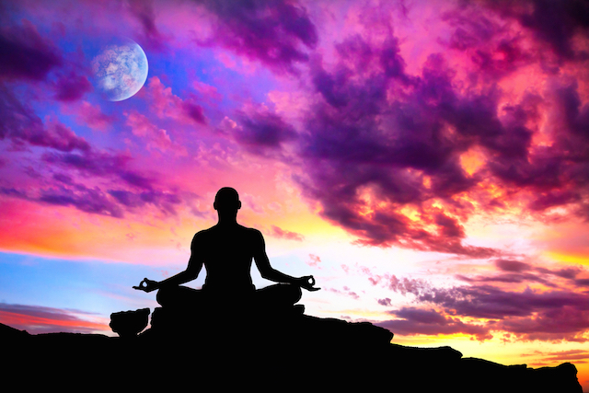
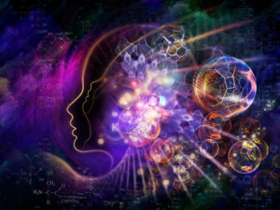
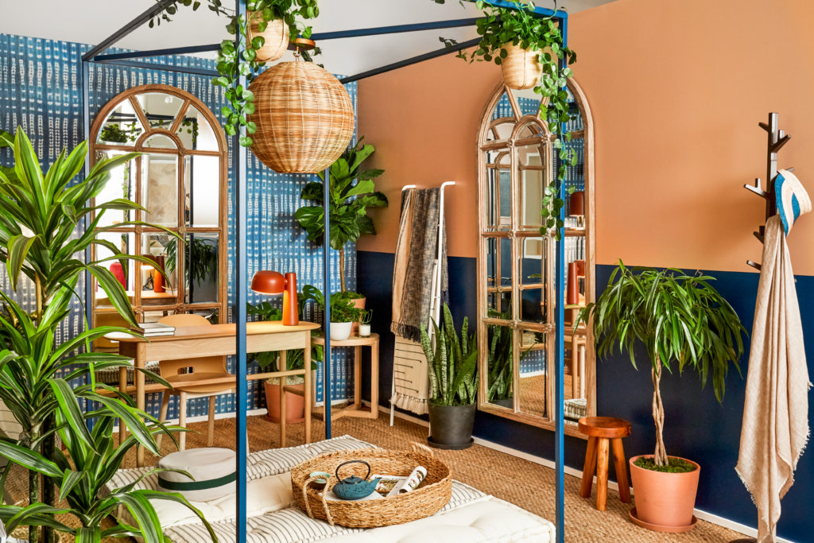
3 Hobby Images
Source of Images:
https://holisticharmony.com.au/training/metaphysics/
https://tinybuddha.com/blog/why-its-okay-to-fail-at-meditation-90-of-the-time/
https://bloomscape.com/green-living/how-interior-designers-use-plants-in-design/

Slide 8
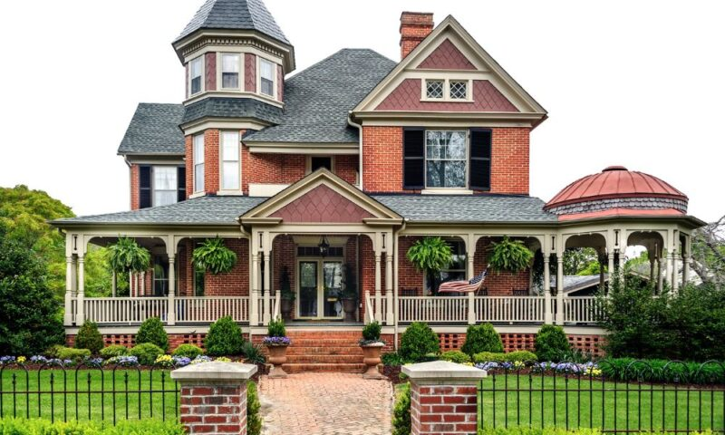
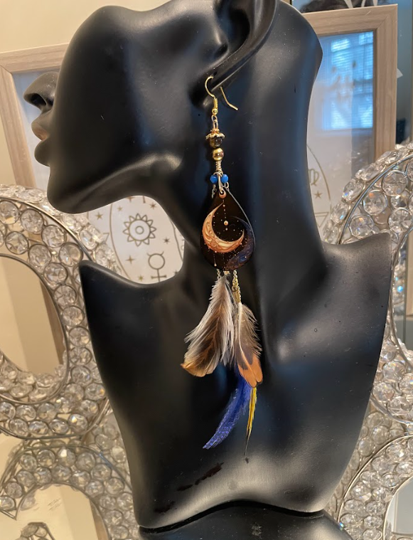
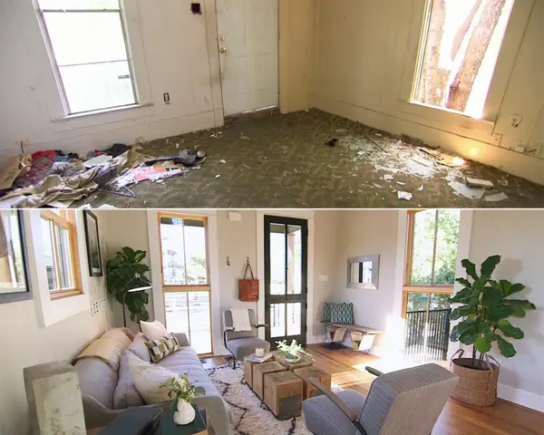
3 Goals & Accomplishments Images
Source of Images:
https://mrspindle.com/blog/4-interesting-fun-facts-about-victorian-houses/
https://www.businessinsider.com/fixer-upper-before-and-after-photos-2017-8

Slide 9
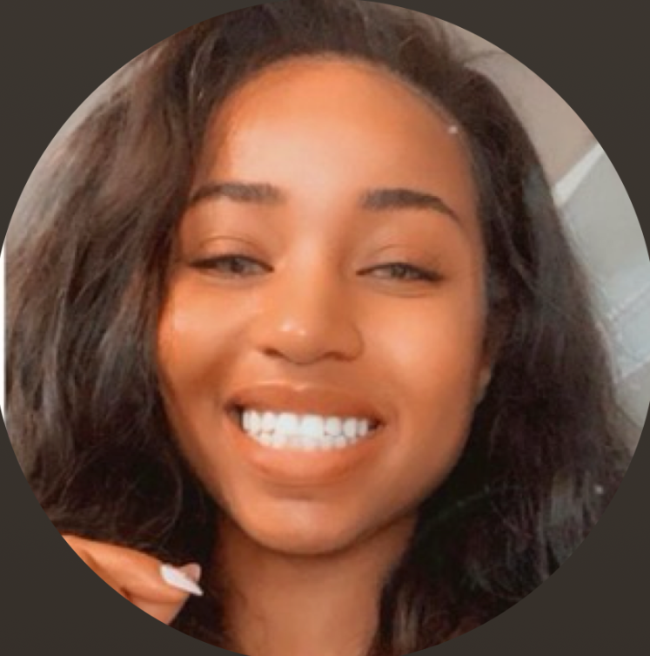
1 portrait

